Slide 1
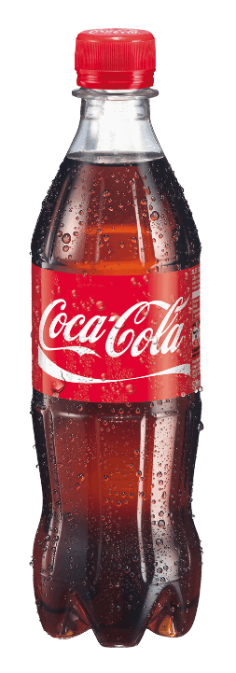
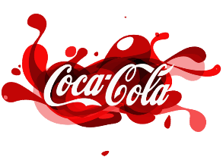
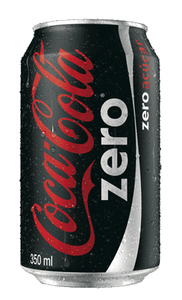
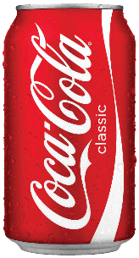
Financial Analysis by Group 4:
Zitong, Shreya, Xinhao, Kevin
Notes:
slidesppt.net

Slide 2
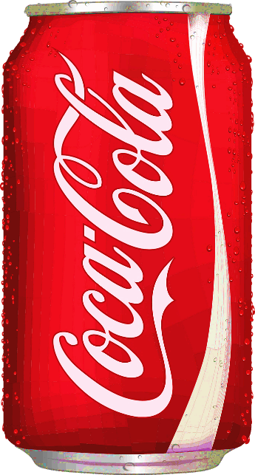

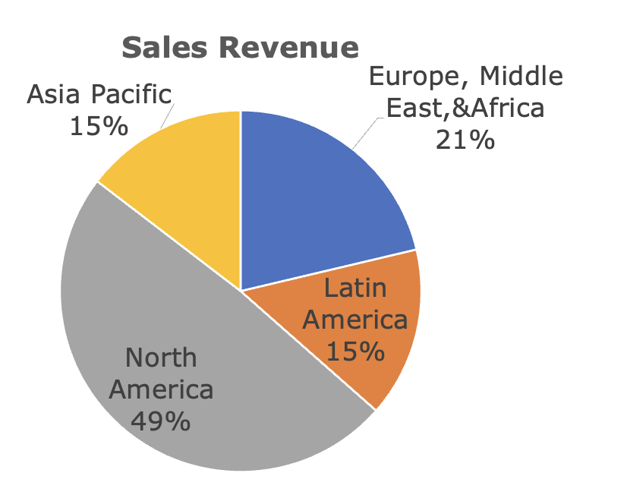
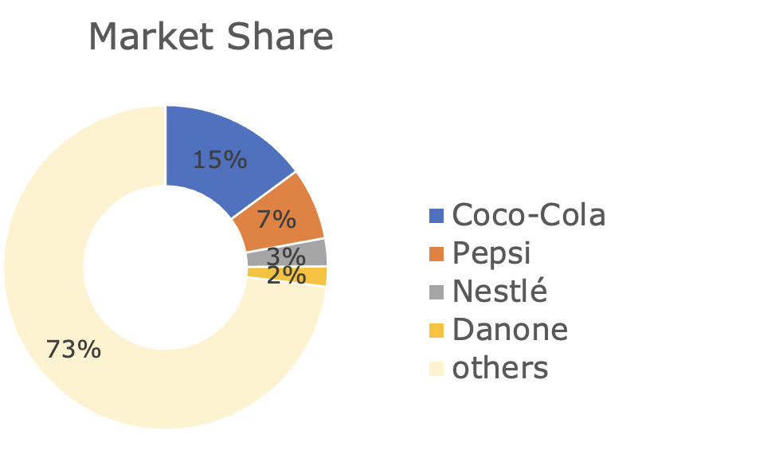
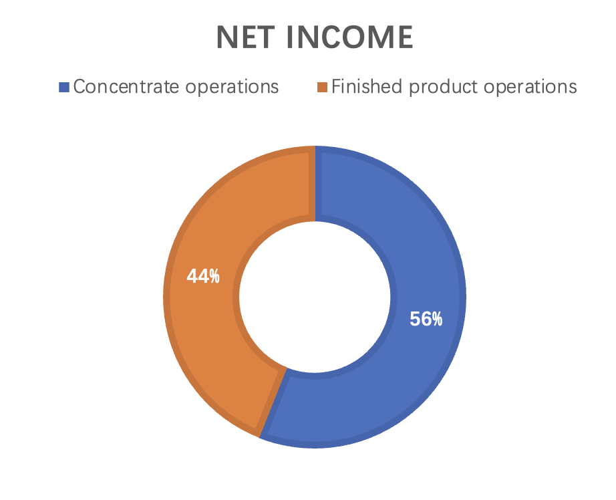
Brief introduction
A beverage company provides nearly all kinds of soft beverage products with market capital of 256.33 billion dollars
Two main kinds of product
——concentrated products and finished products
North America provides the most revenue
Greatest market share in the soft beverage market
03
Get a modern PowerPoint Presentation that is beautifully designed. I hope and I believe that this Template will your Time.

Slide 3
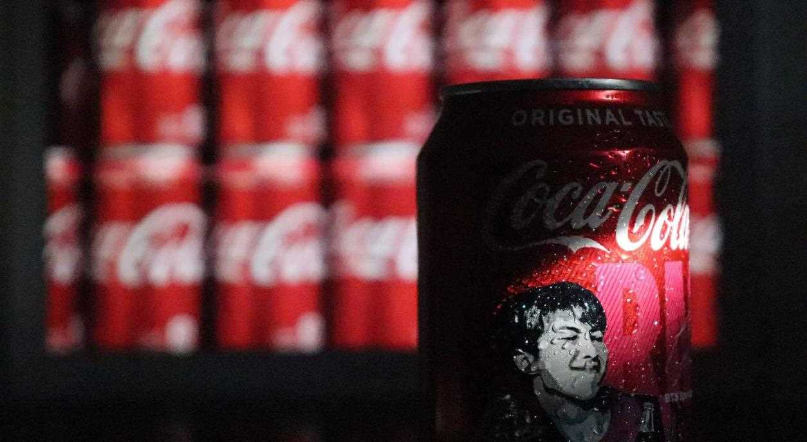
Credit and Risk Analysis

Slide 4
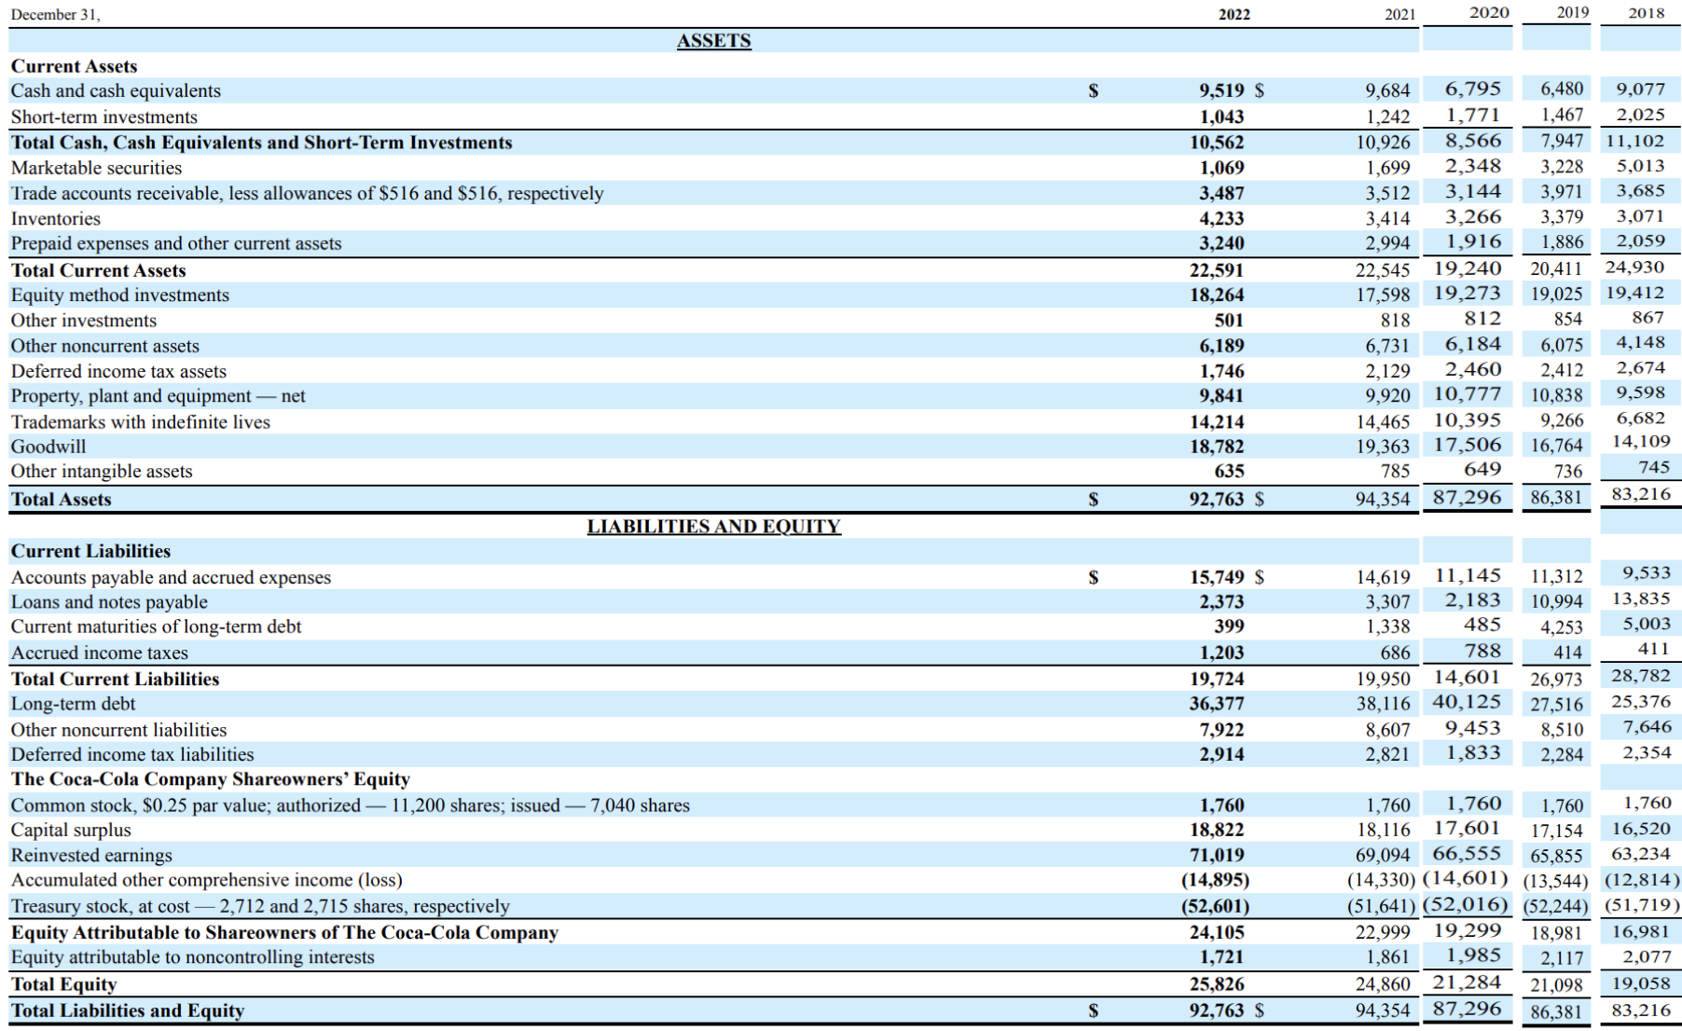
In 2018, Coca-Cola Zero Sugar saw record success, in 2019, refranchising costs and a strong dollar led to a decline.
Rising cash and current assets enhance its liquidity profile, indicating a positive short-term credit risk outlook.
Assets and liabilities are aligned, indicating effective financial management.
Assets surpassing liabilities indicating well positioned for short-term solvency.
The total assets are substantial, showing a strong asset base.
This might provide collateral options for secured lending if needed.
With low current maturities of long term debt compared to total long-term debt, the company effectively manages debt without facing immediate repayment pressure.

Slide 5
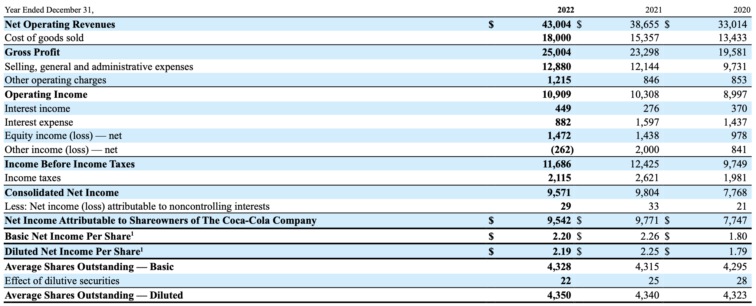
Net operating revenues have increased each year from 2020 to 2022, indicating that the company is growing its sales and potentially its market share
A decrease in interest expense shows that Coke paid off some debt. Usually, as we all know, reduced debt can be a good thing
consolidated net income has increased over the years reflecting overall profitability and financial health. This suggests a positive trend in the company's ability to generate profits.

Slide 6


Financial Ratio
Ratios | 2022 | 2021 | 2020 | 2019 | 2018
Current Ratio | 1.15 | 1.13 | 1.32 | 0.76 | 0.87
Total Asset Turnover Ratio | 0.46 | 0.41 | 0.38 | 0.43 | 0.41
Return on Assets | 10.32 | 10.39 | 8.9 | 10.4 | 7.78
Net Profit margin | 22.26 | 25.36 | 25.53 | 24.11 | 18.88
Operating Profit Margin | 25.37 | 36.27 | 33.88 | 31.48 | 26.75
Debt to equity Ratio | 1.51 | 1.72 | 2.01 | 2.02 | 2.32
Time Interest Earned | 12.37 | 8.78 | 7.78 | 12.4 | 9.66
current ratio > 1, then the company is liquid or financially well off for the short term.
The decline in Operating Profit Margin in 2022 signals potential issues with the company's financial stability and efficiency. Such a downturn might affect its debt servicing capability and financial commitments, thereby posing risks to its credit standing.
The increase in asset turnover and ROA is positive, showing the company is becoming more efficient in using its assets.
A decreasing D/E ratio signals enhanced creditworthiness, as lower leverage implies reduced risk and potentially better borrowing terms.
Coke has continually increased its net profit margins,however in 2022 we see a decline which could be a concern
Higher the Times interest earned ratio , the more likely a company is to be able to afford its interest payments.
The company's total equity is approximately $26 billion. Aiming to keep a moderate D/E ratio of 2, the maximum potential debt capacity would be $52 billion. With current debts totaling $36.776 billion, the company could potentially take on an additional $15.224 billion in debt and still maintain a debt-to-equity ratio under 2. But keeping in mind liquidity ratio, we propose 1 billion USD.
The company's solid liquidity, efficient use of assets, good interest coverage, and decreasing debt suggest low credit risk, despite a recent dip in profitability which is somewhat mitigated by a historically stable financial performance, we suggest a credit limit of 1 billion USD

Slide 7
Financial Ratio
Ratios | 2022 | 2021 | 2020 | 2019 | 2018
Current Ratio | 1.15 | 1.13 | 1.32 | 0.76 | 0.87
Total Asset Turnover Ratio | 0.46 | 0.41 | 0.38 | 0.43 | 0.41
Return on Assets | 10.32 | 10.39 | 8.9 | 10.4 | 7.78
Net Profit margin | 22.26 | 25.36 | 25.53 | 24.11 | 18.88
Operating Profit Margin | 25.37 | 36.27 | 33.88 | 31.48 | 26.75
Debt to equity Ratio | 1.51 | 1.72 | 2.01 | 2.02 | 2.32
Time Interest Earned | 12.37 | 8.78 | 7.78 | 12.4 | 9.66
current ratio > 1, then the company is liquid or financially well off for the short term.
The 2022 drop in Operating Profit Margin hints at financial challenges, potentially affecting debt management and credit standing.
The increase in asset turnover and ROA is positive, showing the company is becoming more efficient in using its assets.
Coke's net profit margins notices a decline in 2022, raising concerns.
A decreasing D/E ratio improves creditworthiness, signaling reduced risk and possibly better borrowing conditions.
Higher the Times interest earned ratio , the more likely a company is to be able to afford its interest payments.

Slide 8
Three Main risks
01
Macro factors risk
War, inflation, exchange rates will all cause negative impact on the company’s performance
Consumers care more about their health
02
Carbonated beverages are continue losing market share.
Challenges in non-carbonated beverages
03
Failure attempts cause waste of resources

Slide 9
 | KO | Industry
ROE(Return on equity) | 38.9% | 18%
ROA(Return on asset) | 11.4% | 9%
ROCE(Return on capital employed) | 18% | 13.7%
PE(Price to earning) | 24.3 X | 2.8 X
Beta coefficient | 0.59
It is obvious that Coca-cola performance better than the average of beverage industry
Forecast earning growth | KO | Industry | Certificates of Deposit | US Stock Market
 | 7.9% | 9.4% | 5.4% | 13.4%
Both Coca-cola and the beverage may not be the most profitable choice but less volatile than the average of US market

Slide 10
Credit Limit Proposal
Total Equity: $26 billion
Target D/E Ratio for a company: 2
Maximum Debt Capacity: $52 billion
Current Debts: $36.776 billion
Potential Additional Debt: $15.224 billion to maintain D/E < 2
Loan as a percentage of company's current debt: 2.5%
Final Proposal Considering Liquidity Ratio : $1 billion
CREDIT LIMIT of 1 Billion

Slide 11
Portfolio Investment Analysis

Slide 12
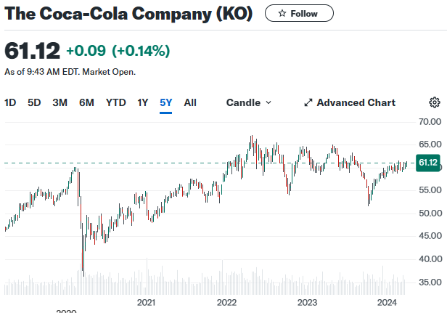
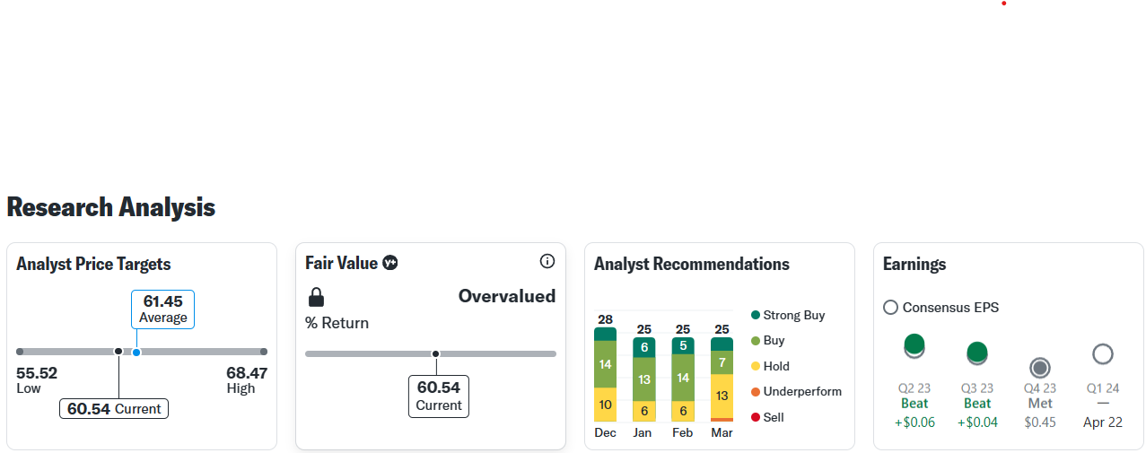
The stock price shows a significant rising trend in early 2020, followed by a peak in 2021.
Between 2021 and 2022, the stock had a lot of ups and downs but stayed mostly high.
Entering 2023, the stock price saw some decline but then started to recover slowly.
Trend: an increasing number of analysts recommend holding Coca-Cola stock instead of buying it.

Slide 13
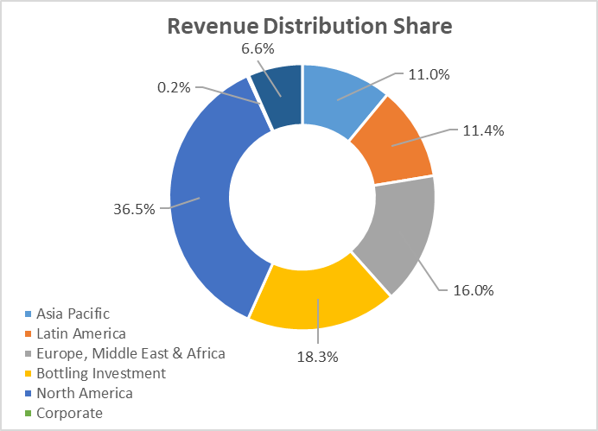
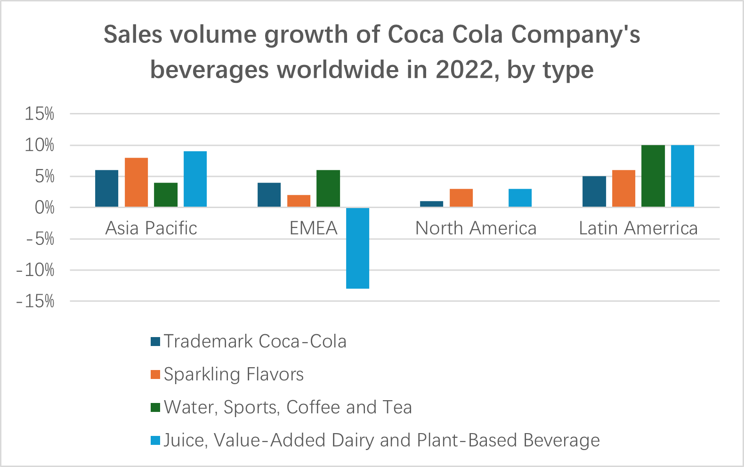
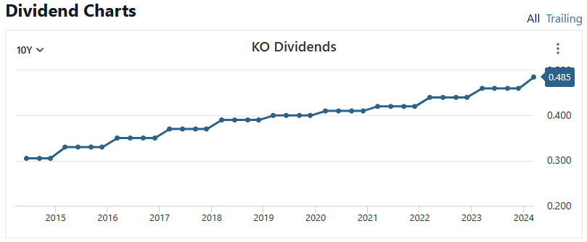
a stable and growing return to shareholders, with the most recent data point indicating a dividend close to $0.485 per share.
These two images indicate that Coca-Cola still has potential to increase its sales in the international market.
a company's good operational health and stable cash flow
Net Revenues grew 11.25% for 2022. ↑
This performance was driven by increasing product prices and changing the sales product mix.
Operating Income grew 5.8% for 2022. ↑
Earning Per Share declined 3% to $2.19. ↓
EPS performance included the impact of an 11-point currency fluctuations.
Cash Flow from operations was $11.0 Billion for 2022, a decline of $1.6 billion versus the prior year, as strong business performance was more than offset by buildup of inventory, cycling working capital benefits from the prior year and etc. in 2022. ↓
Global Unit Case Volume Grew 5% for 2022. ↑
This mixed performance highlights Coca-Cola's resilience amid financial pressures and its ability to maintain revenue growth.
made by The Coca-Cola Company (KO) Dividend History, Dates & Yield - Stock Analysis

Slide 14
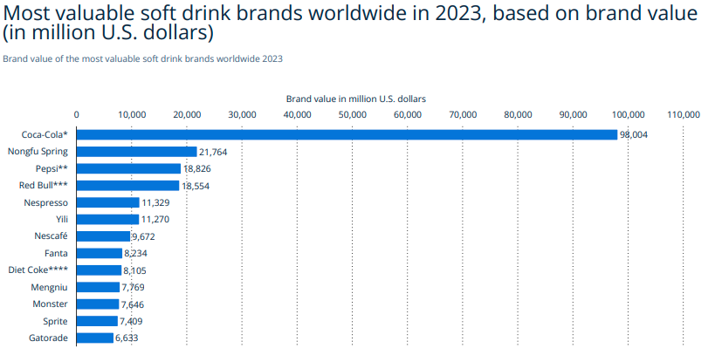
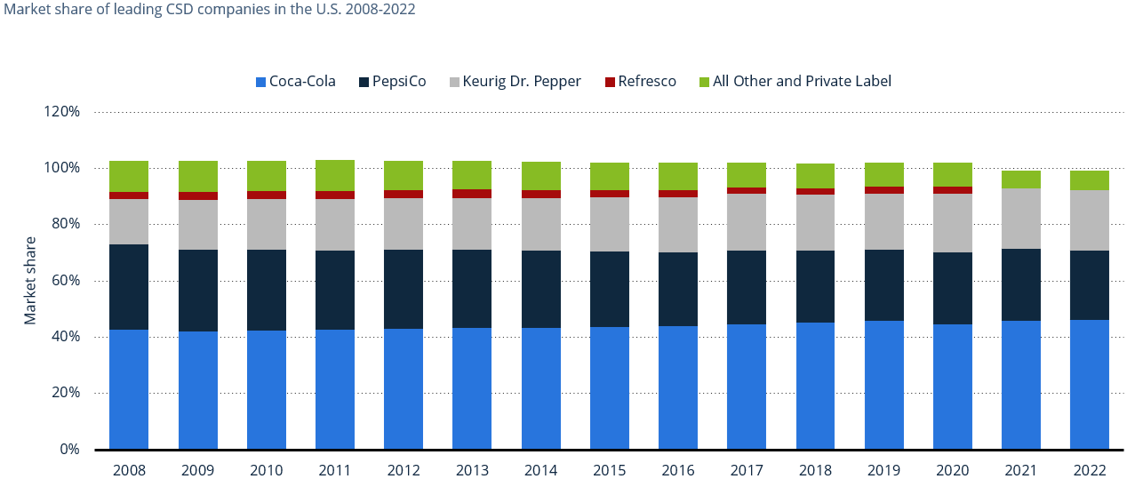
Market Performance
1.Great and stable market share
2. Strong Brand Value
Market share of leading CSD companies in U.S. 2008-2022
1. People Want Healthier Drinks:
More and more people around the world care about being healthy. They are choosing drinks that have less sugar, no sugar, or are made with natural stuff. This could mean fewer people want to drink sugary drinks like the main ones Coca-Cola sells.
Despite Coca-Cola has efficient operations, good financial performance, strong market share and brand value, the health trends and the enactment of health policies in certain countries could impact the selection of Coca-Cola's main product, thereby affecting their profitability. Therefore, the recommendation is to rate the company as "Hold" .
Advise investors to continuously monitor consumer attitudes towards sugary drinks and the potential introduction of new sugar reduction policies.
2. Rules and Taxes on Sugar:
To help with health problems, lots of governments are making rules to cut down on sugar and putting extra taxes on drinks with a lot of sugar.
National policy like “Singapore's sugar tax” could accelerate a shift in consumer preferences.

Slide 15
CFO Treasury Analysis

Slide 16
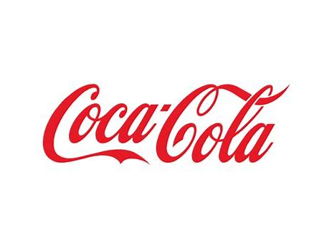
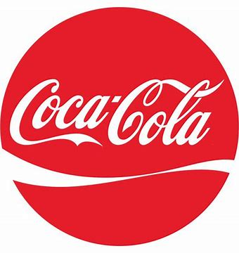
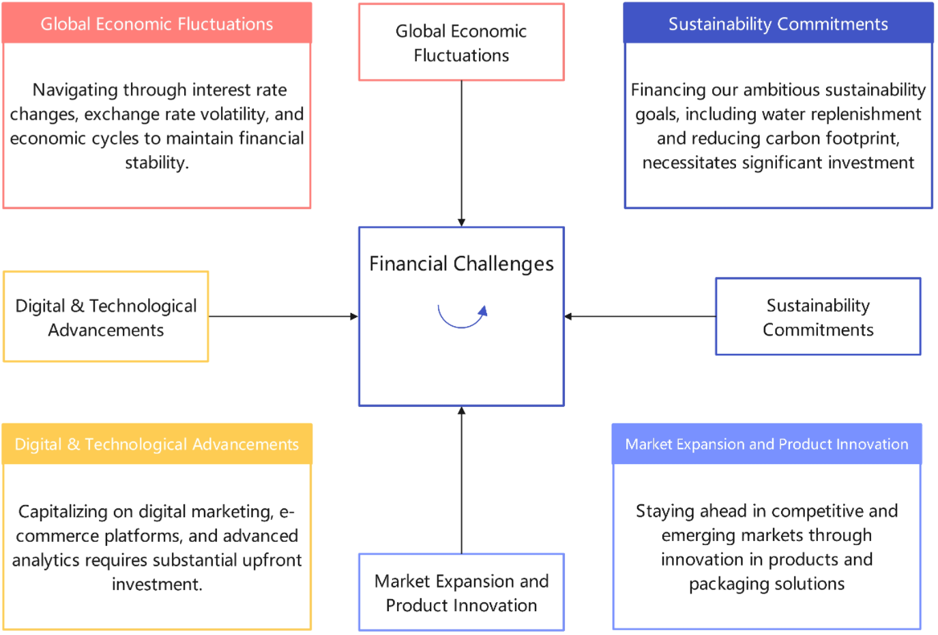
Financial Challenges
Financial Challenges
Funding Needs (2024-2028)
Strategic Funding Initiatives

Slide 17
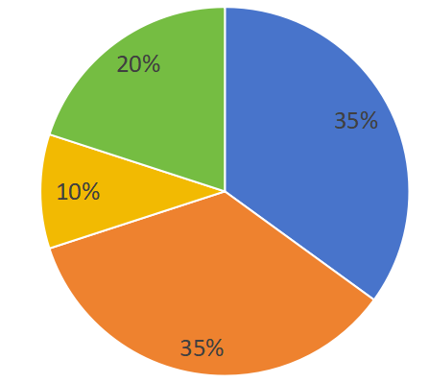
2. Funding Needs (2024-2028)
1 Sustainability Initiatives 20%
Achieve our global sustainability commitments
2 Digital Transformation 35%
Enhance digital capabilities across
operations, marketing, and the supply chain
3 Expansion 35%
Entering new markets and bolstering our presence in existing ones.
4 Debt Management 10%
Improve flexibility and reduce interest expenses.

Slide 18
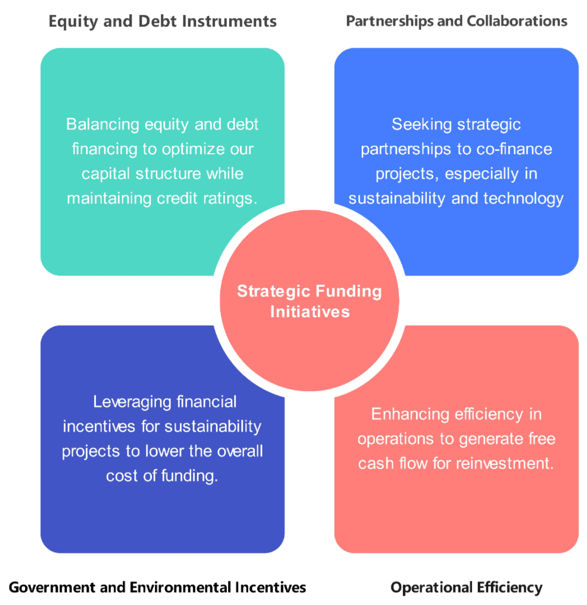
3. Strategic Funding Initiatives

Slide 19

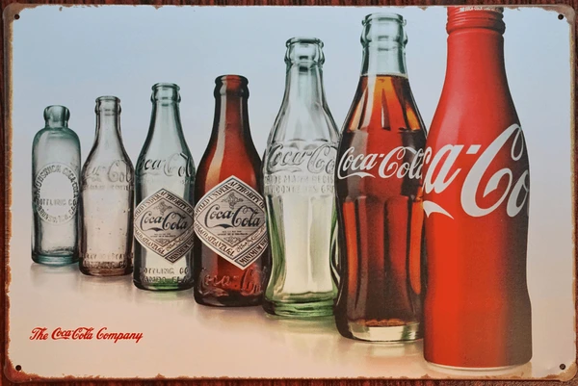
THANK YOU!
Any Questions?

